Slide 1
Health.Mo.Gov

Slide 2
6+++++
Working Together toward Coordinated Care
the Care Notebook in the School Setting
Missouri Department of Health and Senior Services, Special Health Care Needs Family Partnership
Tri-County Health Department
02/21/2025

Slide 3
What You will Learn
In the Next Hour
History of Partnership
Medical Home
Care Notebook
Care Notebook in the School Setting

Slide 4
Teresa McDonald, BSN, RN is the Administrator of Tri-County Health Department. Teresa is a wife and mother of four. She has worked in healthcare for over 25 years. She values meeting the needs of the people she serves. She is currently in her third semester PMHNP Program at WGU.
Teresa McDonald
Administrator, BSN, RN

Slide 5
Pat Fox is a Family Partner with Missouri Department of Health and Senior Services, Special Health Care Needs, Family Partnership. She is a mother of three, one of whom has a rare genetic disorder. She is an advocate and resource specialist for families of children with special needs and has been with the Family Partnership for over 10 years. Pat believes in the whole home/Medical Home approach for health care, which includes using a Care Notebook.
Pat Fox
Family Partner

Slide 6
Slide title
Serves three counties in Northwest Missouri; Gentry, DeKalb and Worth.
Two of the three counties served trend higher than the state average for people living in poverty.
Designated as a health professional shortage area.
Percent of children with a medical home in Missouri measured at 48.7% in 2021.
Tri-County Health Department

Slide 7
What We Did with the Data
using our Maternal Child Health (MCH) Services Contract
As part of Maternal Child Health Services contract, completed local needs assessment and gathered community input.
Using data and community feedback, selected a priority health issue and developed a work plan.
Continued to grow network of like-minded individuals working toward the same goal.
Developed and piloted a Care Notebook and continued to collaborate on a finished product with MO DHSS SHCN.
2021
2021
2022-2024
2023-2024

Slide 8
Slide title
Family Partnership for Children & Youth with SHCN
Provide resource information and peer support to families of children and youth with special health care needs.
Employs a team of Family Partners.
Empowering families to live a “good life”.
Family Partnership Program

Slide 9
“Alone we can do so little; together we can do so much.”
- Helen Keller

Slide 10
Medical Home
“A medical home is an approach to providing comprehensive primary care that facilitates partnerships between patients, clinicians, medical staff, and families. A medical home extends beyond the four walls of a clinical practice. It includes specialty care, educational services, family support, and more.” – American Academy of Pediatrics
Notes:
The definition of medical home from the American Academy of Pediatrics

Slide 11
Medical Home
A medical home is not a building. It is a family centered approach to comprehensive care for a child.
The medical home care team includes anyone who cares for a child
Notes:
Medical Home model has been promoted by Health Resources Services Association ( HRSA) for the past 20 years. The Medical Home has been become a standard of care for all children. It is very important for children with special healthcare needs. Children with special healthcare needs they utilize more care and tend to have more unmet health care needs than other children, but all children need access to this care.
It is a model of care for care for how good primary care is provided. Think about it as a wheel with spokes. You have Primary Care Hub that a. This is where the child can use their personal doctor or a nurse to access their Preventive Care, Acute Care and Chronic Care management. The child can also access Community Services, Support Services and Specialty Care Services. All services are coordinated through and by the Primary Care hub so we have a comprehensive and coordinated care system where a child can access care.
All SHCN program participants receive a Service Coordination Assessment (SCA) The SC complete the assessment by asking a series of questions to determine the criteria is met for a Medical Home. If not, the SC must provide education on a Medical Home. Follow up with resources within the community, helping them with follow up with resources in the community, or the family to find a physician or physician specialist, they know will work together as a team for ensure the SHCN participant meets the criteria for a Medical Home.
All SHCN

Slide 12
Components of a Medical Home
Accessible
Family Centered
Continuous
Comprehensive
Coordinated
Compassionate
Culturally Effective
Notes:
Pat Add Notes: To have a medical home these 7 components must be met. Accessible: Care is available 24/7 Family Centered: You’re input is valued as part of the team. Continuous: The same professionals care for your child until transition into adulthood. Comprehensive: Care includes Checkups, Sick Visits, Therapy, Specialty Care and resources. Coordinated: Everyone on the Care Team works together to develop a care plan, book appointments, provide resources. This includes school nurses. Compassionate: All members of the Care Team genuinely care about the well-being of the child and family. Culturally Effective: Respect and Care is given in a way that respects cultural and preferred language. A family in the NICU believed in the healing powers of gems and stones. They where setup in a certain pattern near the patient. Whenever the patient was moved to a different area the team made sure the pattern was not disturbed.

Slide 13
Accessible
Care is provided for a child in your community 24 hours a day, 7 days a week.
Notes:
Who: Pat Ease of access to obtain care, geographically, and insurance accommodations.
This means that you can easily find care that is within your community.

Slide 14
Family Centered
The Family is the expert on the needs/care of the child and is considered a vital part of the care team.

Slide 15
Children may change locations, schools or transition between care providers, yet we can provide them with comprehensive continuation of care.
Services are delivered in the preferred language, and the care team respects the family’s cultural and religious beliefs.
Continuous and
Culturally Effective
Notes:
This means that you see the same person or persons at each visit. This includes a primary care doctor and specialty care doctors/therapists.
The same primary physician cares for the child from infancy to young adult. After this the primary physician provides assistance and support to an adult physician.

Slide 16
Comprehensive,
Coordinated,
Compassionate
The concept works with multiple providers to develop a care plan, book appointments, handle referrals, and provide access to resources.
All members of the care team are genuinely concerned about the overall well-being of each individual child.
Notes:
This may mean that a you get help to coordinate appointments to multiple specialists on the same day. Someone like a Family Partner helps you find resources you may need, including funding sources for items not covered by insurance.
A care plan is created in partnership with the family and then communicated with all health care clinicians, necessary community agencies and organizations.

Slide 17
Medical Home and Education
Medical home care providers can collaborate with educationally based service professionals to provide educational services for patients. These services can include early intervention and educational services for cognitive, social, emotional, communication, and adaptive development
Notes:
Who: Angie
Care that recognizes that family are their primary care givers and support for a child.
Ensuring, that all medical decisions are made in partnership with the child’s family.
This means that the doctors and other providers listen to what you have to say and include you in on the decisions for care for your child.

Slide 18
3 Steps
To ensure a child has a medical home
Step 01
Step 02
Step 03
The family chooses a primary physician they trust.
The child has a written care plan.
Create a Care Notebook!
Notes:
Who: Pat
Talking points from the Missouri Medical Home brochure

Slide 19
Medical Home
Care Notebook
An individualized notebook that is utilized to ensure care received is coordinated, comprehensive and continuous.
Notes:
Pat Add Notes: A Care Notebook is an important piece of the Medical Home, as it contains information such characteristics of the child, equipment needs, information on all team members, diagnosis etc. The Care Notebook is very helpful should the main caregiver not be available to answer questions. When my son was alive I had a 3 ring binder with what I called “Patrick’s Owner Manual” it provided all the information on taking care of Patrick in case I was not available to ask. This included settings on equipment, list of doctors, providers etc. When we were in the ED instead of me repeating everything about my son to several people I would hand them his “owners manual” and tell them to read that before asking me any questions. More than once the ED doctors would comment how much they loved the “manual” and wished all parents had them. I guess I was ahead of my times, my life would have been a lot easier had I had access to a care notebook than to try to come up with one on my own.
A Care Notebook is an organizing tool for families who have children with special health care needs but ours can be used by anyone to keep track of important information about a child's healthcare.
Tri County Health Department asked Family Partnership to collaborate with ideas and suggestions for informational pages to include in a care notebook.
Missouri Family Partnership and Tri County Health thru the MCH Title V Funding have provided all families attending this years retreat a hard copy Care Note Book. You received this when you checked in.

Slide 20
Medical Home
Care Notebook
Statewide Initiative Collaboration
A Care Notebook was created by Tri-County Health Department.
SHCN Family Partnership collaborated with Tri-County Health Department, to finalize the Care Notebook and make it available to all individuals statewide.
Notes:
A Care Notebook is an important piece of Medical Home, as it contains information essential for others to successfully support the individual and family. Some examples may include diagnosis, medications, equipment needs, etc. The Care Notebook is very helpful, when the main caregiver is not available to answer questions.
Introduce Teresa McDonald from Tri-County Health Department. Teresa will introduce you to the Your Child’s Health Care Notebook created for all families. Teresa’s Bio

Slide 21
Why a Care Notebook Impacts Education
This tool follows the child to ensure all who interact with the child have access to a knowledge base to ensure the best care and education for the child
Follows the child between services and schools
Keeps information organized and easy to find
Provides people who care for the child need to know information
Notes:
Transition Slide Tri-County
Pat this book stays with the child at all times. My sons was located in his backpack on his wheelchair. Just as you wouldn’t leave your driver license at home, make sure that your care note book goes with you.

Slide 22
Care Notebook for School Counselors
Providing a place to record and organize information about students, including counseling notes, case concerns, and more
List the names and contact information of mental, behavioral, or emotional health counselors
Record details about counseling sessions, such as notes and case concerns
Use the notebook to plan for, organize, and track client sessions
Notes:
Transition Slide Tri-County

Slide 23
Care Notebook for School Nurses
Providing a place to keep track of student health information and care provided by the nurse.
Coordinate care with families and health care providers
Document the services provided
Easy to find Emergency Plans
Comprehensive Information Source
Notes:
Transition Slide Tri-County

Slide 24
Care Notebook for Special Accommodations
A child with special needs may have unique accommodation needs
Guided assistance to use School transportation
Special Seating on School Transportation
Medical Equipment that must be maintained during transfer
Assistive devices and how they work
Notes:
Transition Slide Tri-County

Slide 25
Care Notebook for IEP Services
Providing a place to record and track IEP’s
Document interventions, accommodations, or therapies
Share Data between teachers and therapists
Managing IEP goals, monitor progress, evaluate effectiveness
Notes:
Transition Slide Tri-County

Slide 26
What else can a Care Notebook Include? It’s Up to you!
Emergency Plans
Medications
Milestones
Words and Gestures helpful in communicating with the child
Questions and Answers between all Adults that have a responsibility towards the child
Details disability or special need
find the latest therapy report, school assessment, provider phone number, or documented moment of triumph
Notes:
Transition Slide Tri-County As with all kids, how a child reacts or acts outside of home can differ, the notebook can help to also be a communication book between those providing care for a child to better understand situational needs.

Slide 27
Care Notebook
A Care Notebook is essential to help keep the information for the optimal care of a child organized. The Care Notebook is a place to keep all medical records, including appointments past and upcoming, therapies, counseling, medication, diagnosis and more. It is a place to document care, milestones, behaviors, special activities, emergency plans, transportation needs and much more.
Notes:
A Care Notebook can be an App on a phone, or hard copy notebook or file.

Slide 28
How to Use a Care Notebook
Getting Started
Step 01
Step 02
Step 03
Decide what is most important to share and collect information.
Organize the notebook in a way that works for you.
Take your notebook everywhere you go.
Notes:
Who: Pat
Talking points from the Missouri Medical Home brochure

Slide 29
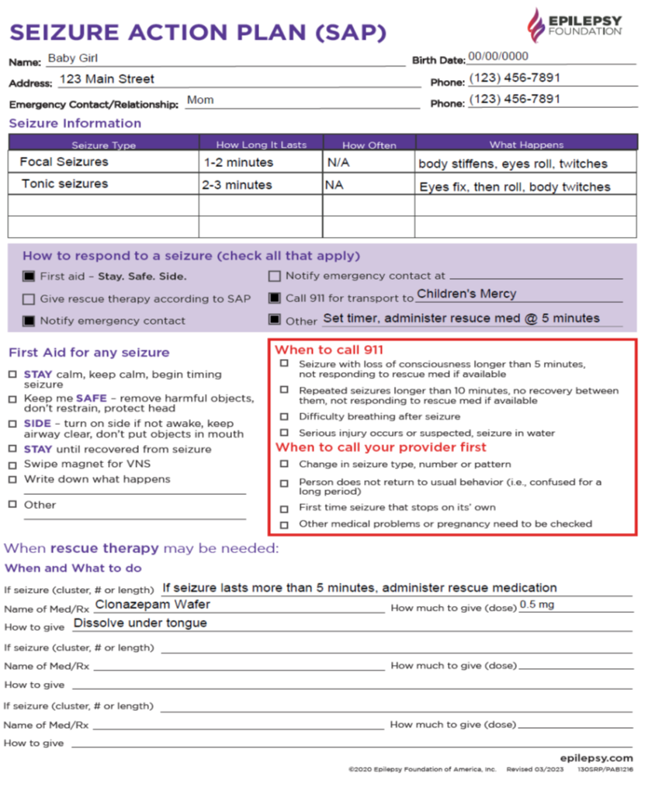

Slide 30
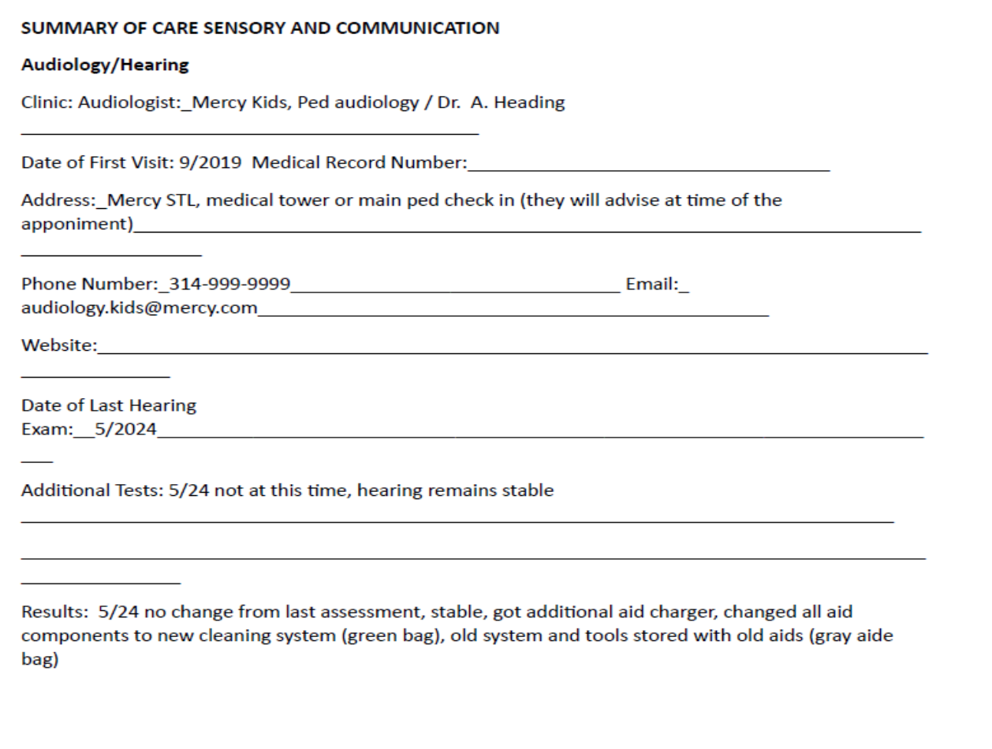

Slide 31
Teresa McDonald
Teresa.mcdonald@lpha.mo.gov
660-783-2707
QUESTIONS?
https://www.tricountyhd.com
Pat Fox
Pat.fox@health.mo.gov
314-409-7915
This project is/was funded in part by the Missouri Department of Health and Senior Services MCH Services Contract # DH220051154 and is/was supported by the Health Resources Services Administration (HRSA) of the U.S. Department of Health and Human Services (HHS) under grant #B04MC47428, Maternal and Child Health Services for $12,834,718, of which $0 is from non-governmental sources. This information or content and conclusions are those of the author and should not be construed as the official position or policy of, nor should any endorsements be inferred by HRSA, HHS or the U.S. Government.
https://health.mo.gov/living/families/shcn/familypartnership/

